Slide 1

LearnDrive ADVISOR Mariam Manakkadu, Sheheeda

Slide 2

Problem Definition:
The problem of this project is If a person wants to learn driving, either he/she has to contact the driving school which is too expensive or has to contact other people for learning.Consuming time to learn driving which is not convenient and pickup and drop off to driving school is also expensive sometimes. We have to overcome all these problems through our mobile application. This is new application
There no exsting mobile application like this.

Slide 3
Evidence that the Problem Exist:
Going to a new country doesn’t know about rules. However, people know driving they can’t drive. Those people need some help to seek rules in a new country. Many people have driving licenses, however, some people have only a few skills they want upgrade skills.
According to the reports from U.S News & World Report Driving Habits Survey 2022, safety driving has decreased to 60%, therefore proper learning and valid license is necessary. People are struggling to learn driving because it is expensive to get it through the schools.

Slide 4

Benefits of Solving the Problem:
Users that are not finding a place to learn can be beneficial with low cost and tutors such as Uber and Door Dash Drivers are highly beneficial as well as they get extra earnings in the form of fee. Applications like this can be very impactful to the society to ensure that people can learn safe and easy driving.

Slide 5
Solution-
The solution of this problem we have to create a online source to learners who want to learn driving as well as drivers to teach.
And we have to provide low-cost service to user can able learn driving because driving schools are too expensive most of the people can’t affordable and also seeking traffic rules in new country through the native drivers that is also so useful to users who are always travelling as well as want to drive. These are solutions for this project.

Slide 6

High-Level requirements-
Designing a mobile IOS Application is an easier way to reach multiple users. User-Friendly and reliable applications are important for the growth of the application. Booking and learning through the existing driver in a few hours is much more convenient than spending day- day in driving schools. When a user sets up a time and picks up location, it instantly shows up the drivers and their availabilities to match with the requirements. The payment plan and their methods have been processed in the next page of the booking.

Slide 7
CREATE ACCOUNT | SIGN UP IN APP | YES
BOOK A DRIVER | TUTOR | YES
USER TIME CONIVENCE | SLOTS | YES
PICK UP AND DROP-OFF | DOORSTEP | YES
2 HOURS CLASSES | LOW –COST MIN-40$ | YES
LEARN DRIVE(OUR APPLICATION)

Slide 8
DRIVING SCHOOLS
CREATE ACCOUNT | SIGN UP IN APP | YES
BOOK A DRIVER | TUTOR | NO
USER TIME CONIVENCE | SLOTS | NO
PICKUP AND DROP-OFF | DOORSTEP | NO(SOMETIMES BUT EXTRA MONEY)
2 HOURS CLASSES | LOW-COST-40$ | NO(MIN 200$)

Slide 9
We are adding additional features like in our application.
LAERING DRIVING(FEATUIRES)
Basic(Learn from starting)
Medium(Know some driving but not fully)
Advance(Known all driving skills but want to trail once in new place or revise)

Slide 10

Methodology
PLANNING-
We using the quantitative methologly-here the questionaries link- https://forms.gle/u5Gj3czDMNVZFiN66
Population – Smartphone users between 18-30 age people.
Sample size- We have to collecte all reposenses from smartphone users .
We have conducted the survey of the sample of 80 responses for analysis.
Instrument- we are using questionaries as a instrument to send users and get responses.
As per the responses we are planning to design an app to solve this problem that makes to users easy to book a driving tutor.
Design-
Creating a booking a tutor feature and two interfaces login as a user and login as a driver
Select options like level of driving need basic, medium and advance.
Sheduling a time to conivence user and driver
Techniques:
Creating an ios application to solve this problem using swift and tool xcode design and firebase, Node js

Slide 11
Technical Requirements
Swift Programming - Swift is a programming language developed by Apple Inc. for developing applications for iOS, macOS, watch OS and type OS platforms.
Node JS
Node.js is an open-source, cross-platform, back-end JavaScript runtime environment that executes JavaScript code outside of a web browser.
Stripe SDK
Stripe is a popular payment gateway that provides a secure and reliable platform for businesses to accept and manage online payments. Stripe's SDK (Software Development Kit) is a set of tools that enables developers to integrate Stripe's payment processing services into their iOS applications.

Slide 12
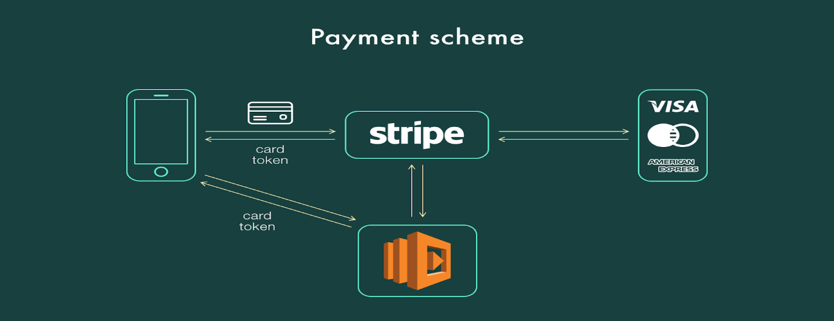

Slide 13

Firebase :
Firebase is a mobile and web application development platform, which provides a wide range of backend services to developers. It is a cloud-based service that enables developers to build, test, and deploy applications
AWS Lambda -
AWS Lambda is a serverless computing service offered by Amazon Web Services (AWS) that allows developers to run code in response to specific events or triggers without having to provision or manage any servers.

Slide 14

X Code
Xcode is an integrated development environment (IDE) for developing software applications for Apple's platforms, including iOS, macOS, type OS, and Watch OS. It is a powerful tool for developing apps, and it is the primary tool used by iOS developers. Xcode has been designed to provide developers with all the necessary tools for creating iOS applications, from coding and debugging to testing and publishing.

Slide 15

Overview of the Project :
Using X-Code (IDE) as an environment, our project uses Swift programming to write our code into develop our application. In that environment, we have our storyboard spaces to display our screens with the use of View controller to modify or write our code for the application.
We used Segue to connect and push the screens into each other so that they are interconnected by the Swift programming code.
After connecting Segue, we write the code programmatically to display the pages whenever we want. They have buttons, labels, UI text fields, space bar and set up the keyboards using SDK.
Side Menu SDK has also been used to put more fields into the application.
Firebase auth is used for the authentication for User and driver login and sign up.
Fire store, it is the database to store all the data in the IOS application to retrieve and used for the future.
Map kit has been attached to our application to display the map for the user’s location and directions to the destination location and also search for the destination location.
UI Time picker, we have used to select for user and driver to schedule the time slots.

Slide 16
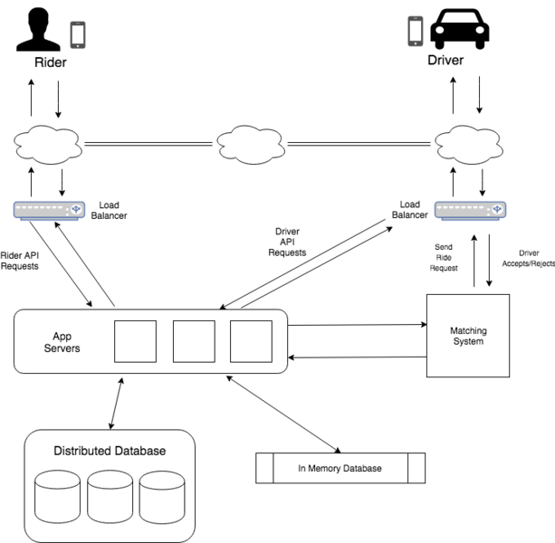
Basic Architecture of our project

Slide 17
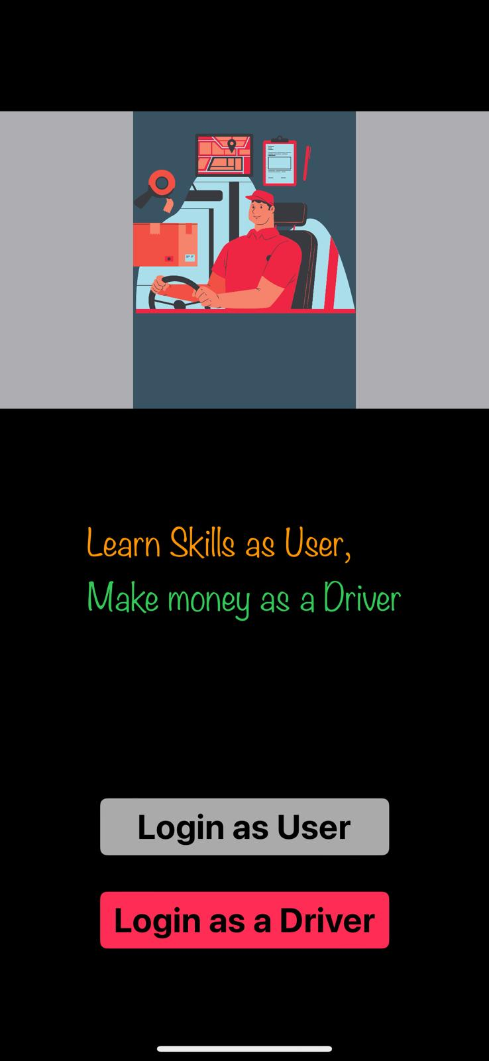
Results

Slide 18
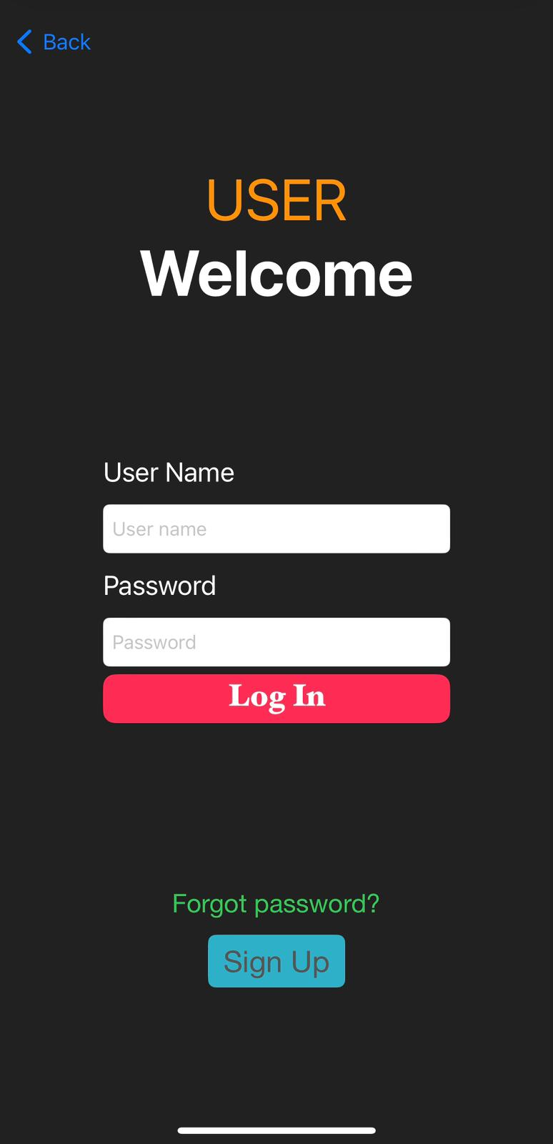
User login

Slide 19
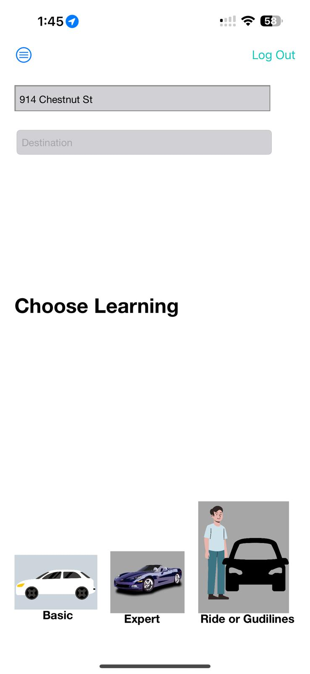
User home

Slide 20

Driver interface

Slide 21
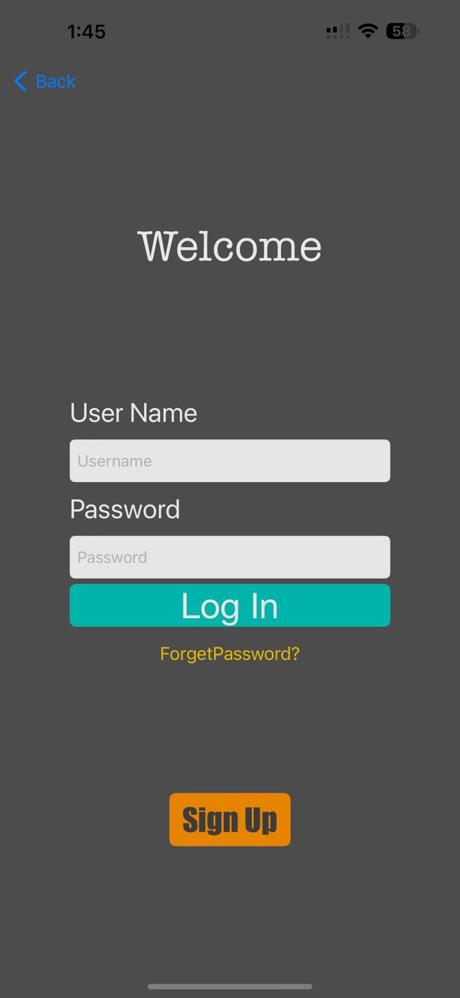
Driver login

Slide 22
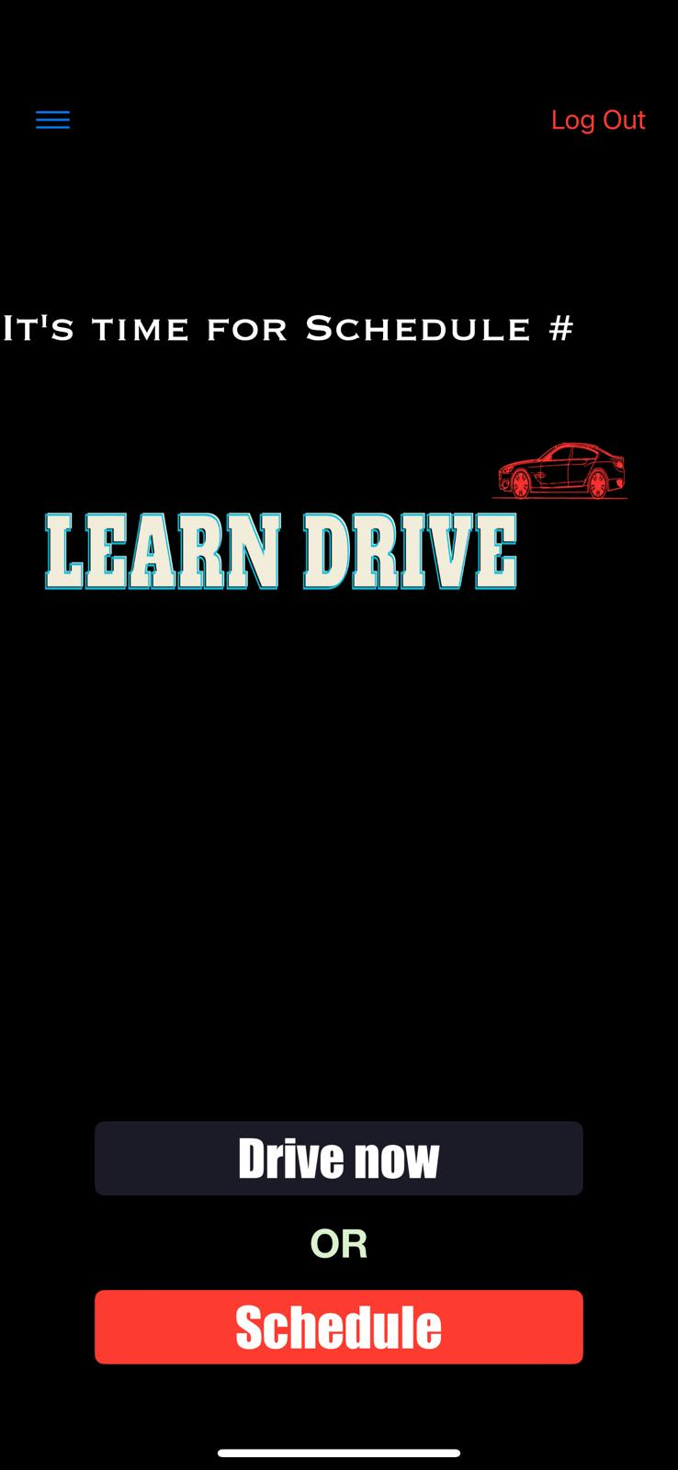

Slide 23
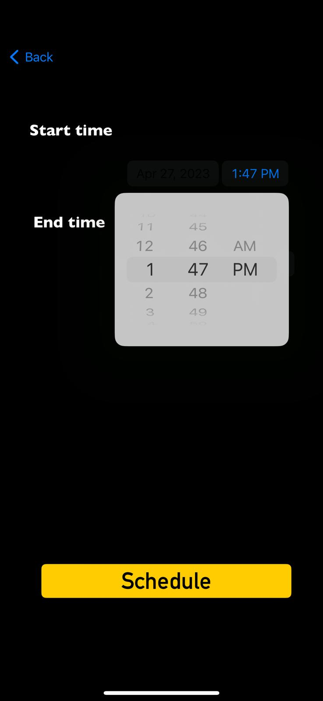
DRIVER SCHEDULE INTERFACE

Slide 24

CONCLUSION
In conclusion, the Learn Drive project is an innovative solution to the problem of high cost and inconvenience associated with traditional driving schools. By leveraging mobile technology and real-time matching algorithms, the project enables users to easily find and book affordable and convenient driving lessons with experienced drivers. Throughout the development process, we utilized several cutting-edge technologies such as Swift programming, Firebase backend, Stripe SDK, and AWS Lambda, to create a user-friendly and reliable mobile application. The application's design includes several key features, including booking management, driver tracking, payment processing, and user feedback, to ensure the best possible experience for both users and drivers.

Slide 25
TEAM WORK
DHARMA TEJA DONEPUDI
user interface
Design view controllers
Implementation
Swift code
Firebase ,firestore
AWS lamda
VAMSI KRISHNA ANANTHANENI
Driver interface
Design view controllers
Implementation
Swift code
Firebase ,firestore

Slide 26

THANK YOU

